Slide 1
ELL305: Computer Architecture Microarchitecture: Data and Control Path
Instructors:
Saurabh Gandhi
gsaurabhr@iitd.ac.in
https://web.iitd.ac.in/~gsaurabhr
Room 323, Block-2
Course coordinator
Tapan Kumar Gandhi
tgandhi@ee.iitd.ac.in
https://tapankgandhi.com/
Room 413A, Block-2
Fall 2023

Slide 2
Policies
Evaluation
Minor exam: 40 marks
Major exam: 40 marks
In class participation / surprise quiz / assignments: 20 marks (normalized based on all evaluations except minor and major)
Attendance: no separate policy other than the in-class evaluation component
Grading will be relative
Audit pass: 30 marks
Re-exam: No re-examinations. If you are unable to attend an exam (minor/major), you need to give prior intimation at least 1 hour in advance, with documentary evidence for the reason for missing the exam (from or vetted by IITD hospital). In such cases, the score for up to 1 exam will be extrapolated from the remaining evaluation components.

Slide 3
Policies
Course material
S.R. Sarangi. Computer Organization and Architecture (textbook)
Dr. Ranjani Parthasarathi. Computer Architecture: Engineering and Technology. (textbook) Available publicly at: https://www.cs.umd.edu/~meesh/411/CA-online/
Learning objectives (At the end of the course, you will be able to...)
Build your own computer
Understand and explain how a general purpose computer works in terms of its building blocks
Explain the general principles behind the design for CPUs, memory systems, instruction sets etc.
Explain different ways in which these subsystems are optimized for increasing the performance of a computer
Appreciate new and radical aspects of computer architecture going forward in the future
**Take extensive notes: my slides do not contain everything that I say or that is important**

Slide 4
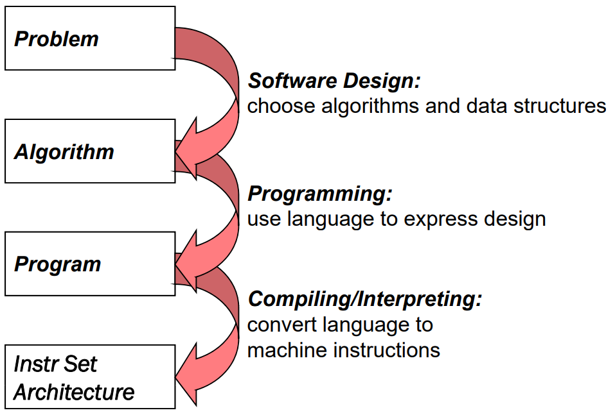
How do we solve a problem using a computer?
A systematic sequence of transformations between layers of abstraction
Notes:
Abstraction layers – no need to know the details of what is going on below!

Slide 5
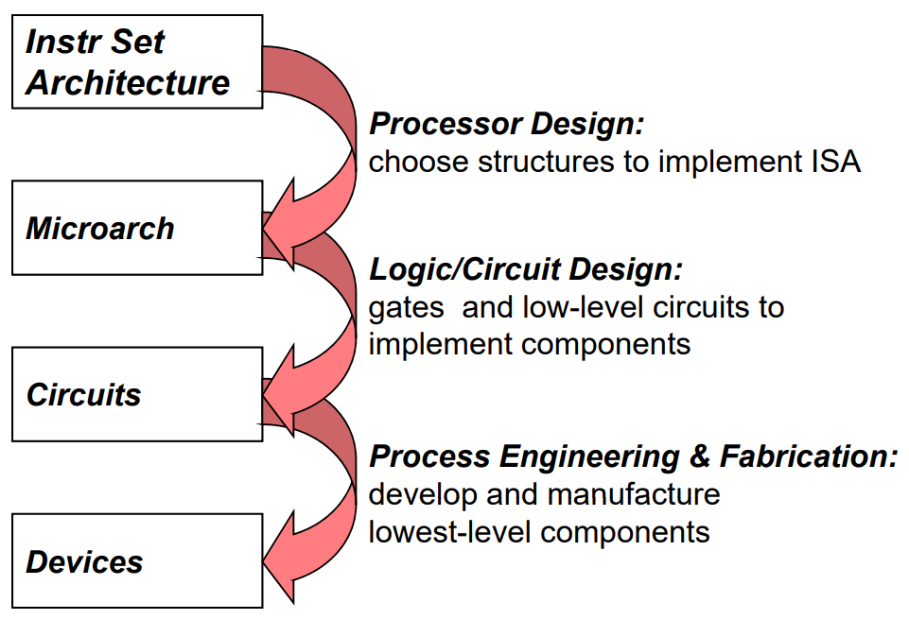
How do we solve a problem using a computer?
A systematic sequence of transformations between layers of abstraction
ELL201

Slide 6
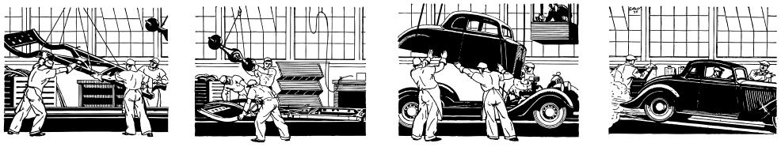
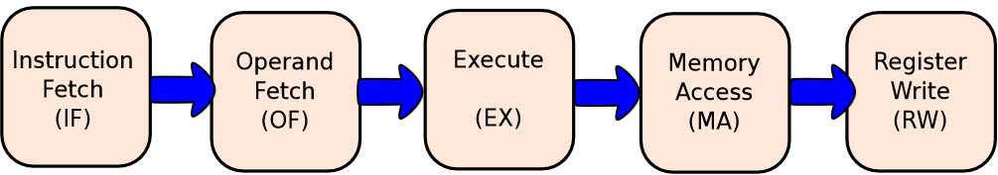
How is an instruction executed?
Goal: Create a “circuit” of logic elements that, when given an assembly instruction, perform the action the instruction describes

Slide 7
The stages of instruction execution – Instruction Fetch (IF)
Which instruction to fetch? Logical elements to compute the address of the next instruction
Next instruction – easy, just increment the current instruction address by size
Branch – depends on the outcome of the current instruction (information obtained from other units of the processor

Slide 8
The stages of instruction execution – Decode and Operand Fetch (OF)
How to interpret the instruction? What all will be needed to execute it?
Processing required for different instruction types is very different – load-store instructions use a dedicated memory unit, whereas arithmetic instructions do not
Types of instructions (in RISC): R-type I-type S-type B-type U-type J-type
Notes:
R-type: register-register.
I-type: short immediates and loads.
S-type: stores.
B-type: conditional branches, a variation of S-type.
U-type: long immediates.
J-type: unconditional jumps, a variation of U-type.

Slide 9
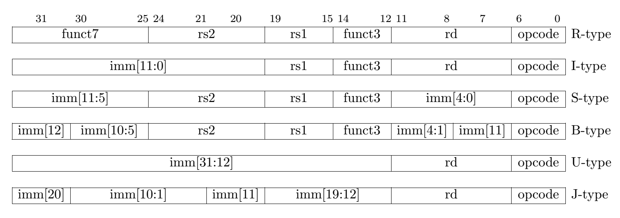
The RISC-V instruction formats
Notes:
R-type: register-register.
I-type: short immediates and loads.
S-type: stores.
B-type: conditional branches, a variation of S-type.
U-type: long immediates.
J-type: unconditional jumps, a variation of U-type.

Slide 10
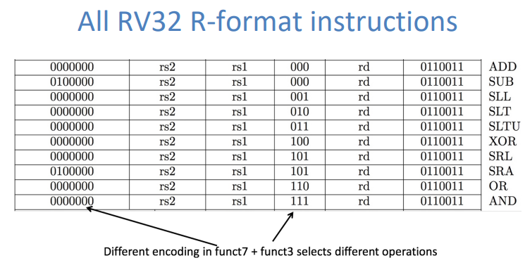

Slide 11
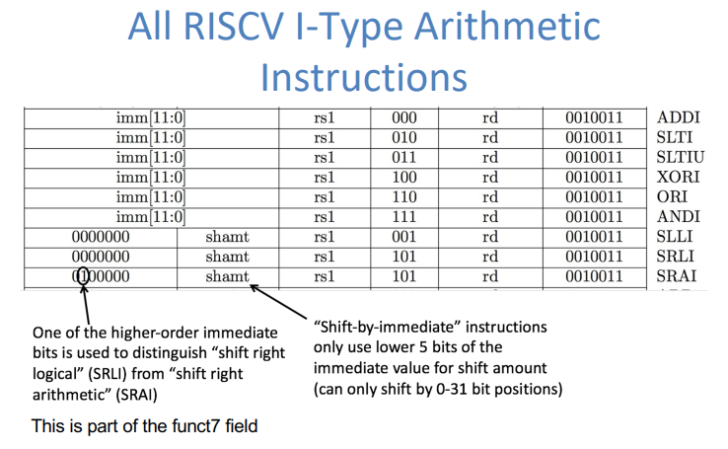

Slide 12
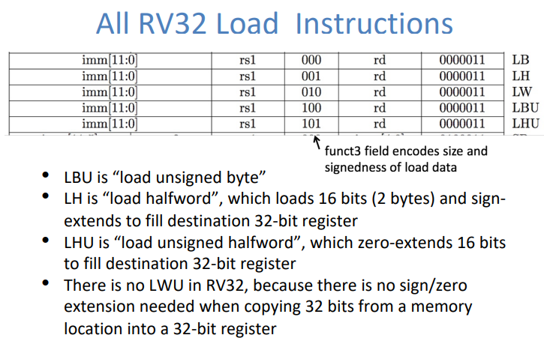
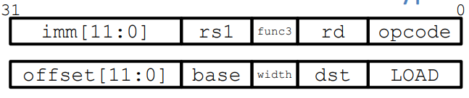

Slide 13
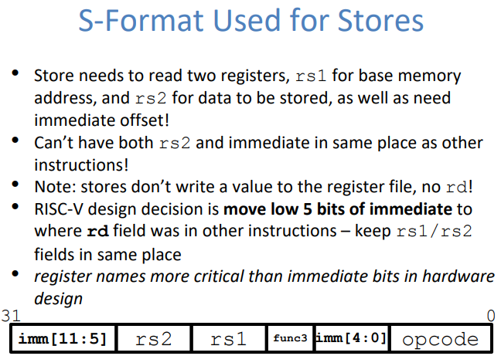
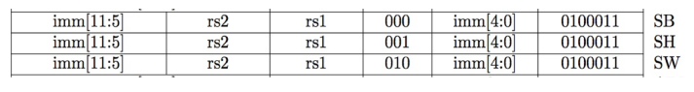

Slide 14
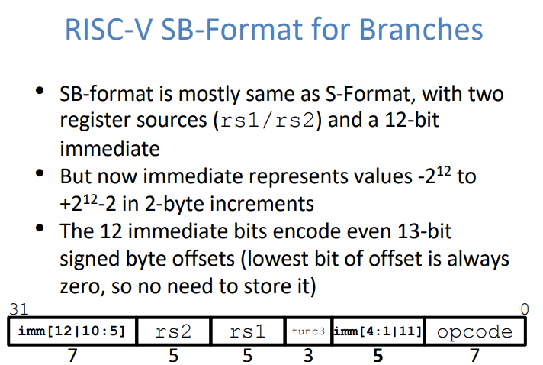
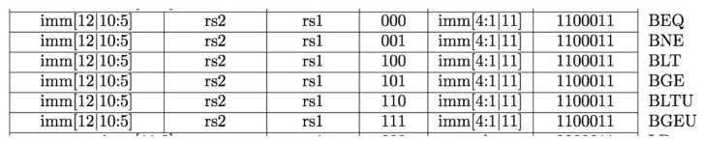

Slide 15
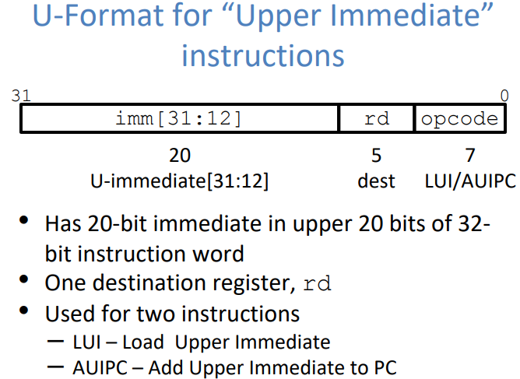

Slide 16
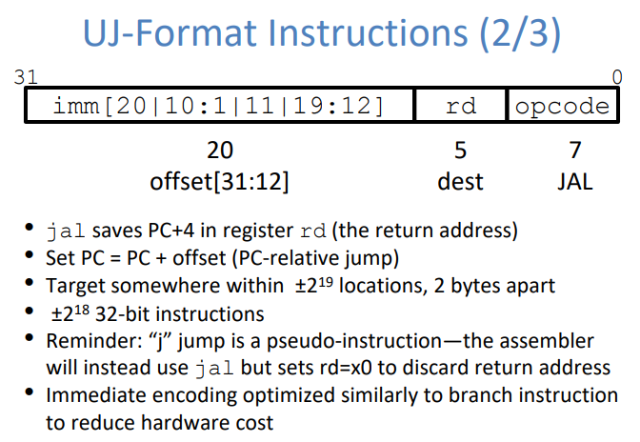

Slide 17
The stages of instruction execution – Execute (EX)
Executes arithmetic and logical operations
Contains an arithmetic and logical unit (ALU)
Compute the effective address of load-store operations
Computes the outcome of branches

Slide 18
The stages of instruction execution – Memory Access (MA)
Processing load-store instructions (accessing main memory)
Memory system can be very complex, and part of that complexity is implemented here (next module!)

Slide 19
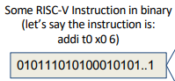
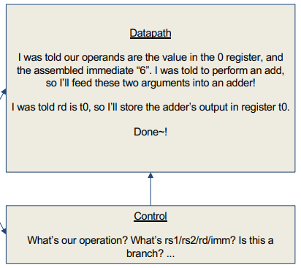
Data and control path
Datapath: contains the hardware necessary to perform operations required by the processor Reacts to what the controller tells it! (ie. “I was told to do an add, so I’ll feed these arguments through an adder)
Control: decides what each piece of the datapath should do What operation am I performing? Do I need to get info from memory? Should I write to a register? Which register? (Based on the input instruction!)

Slide 20
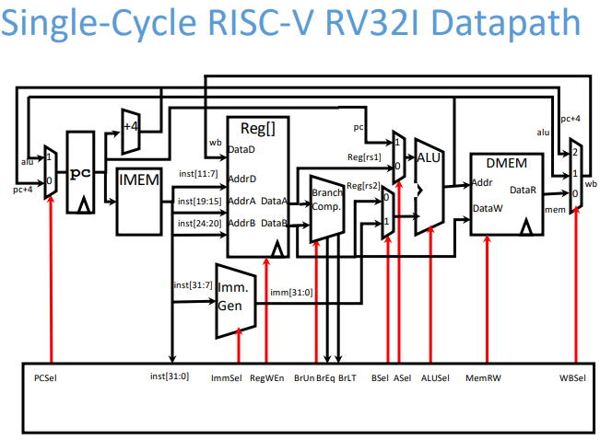
The final product – virtual

Slide 21
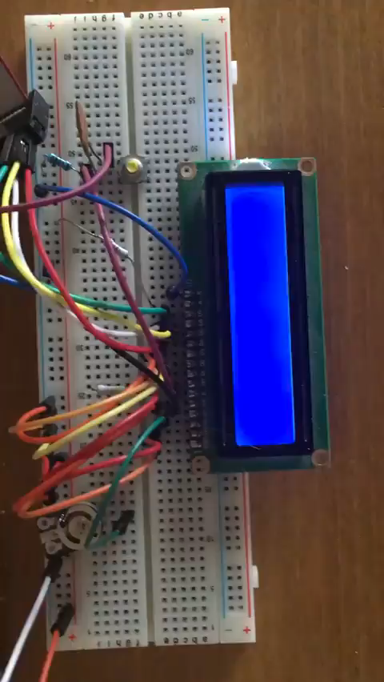
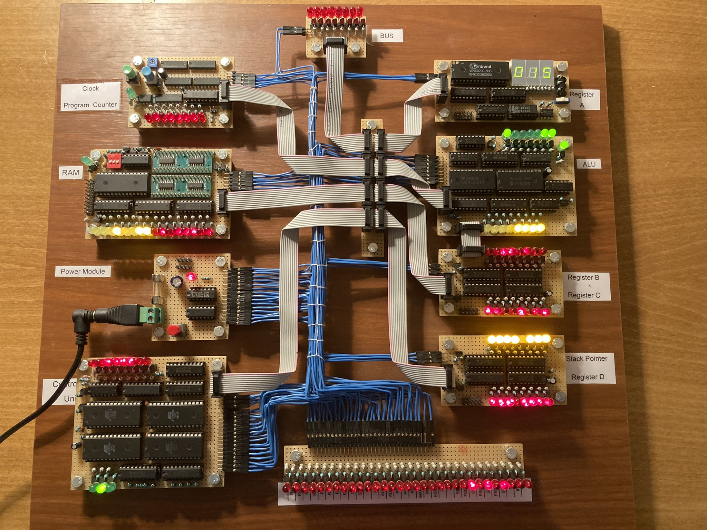
The final product – physical!
https://twitter.com/ten_filip/status/1340400266047332354
https://eater.net/8bit
Try your own: https://hackaday.io/project/178826-pineapple-one/details

Slide 22
How do we get here?

Slide 23
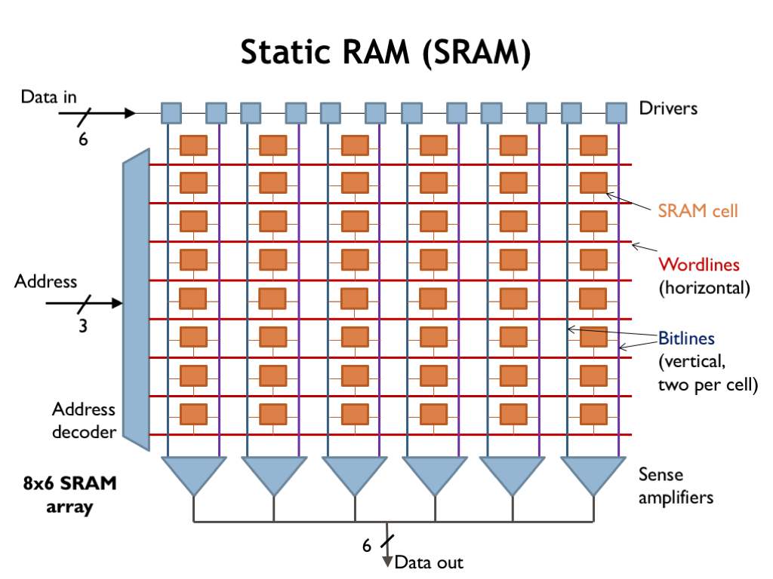
Side note: Accessing data via address and data bus

Slide 24
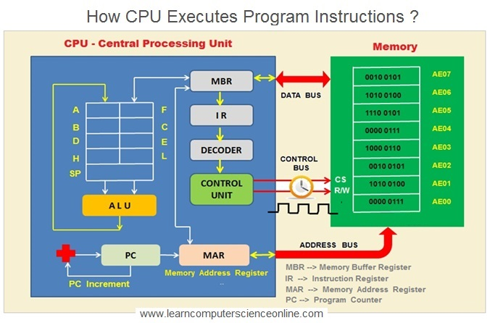
Side note: Accessing data via address and data bus

Slide 25
Building a datapath for R-type instructions
Let us work with an example instruction: add t0 t2 t3
What steps do you need to execute? Remember we had a list of 5 steps:
1. Fetch: add t0 t2 t3
2.1 Decode (parse the instruction and extract different fields): rd = t0; rs1 = t2; rs2 = t3
2.2 Operand fetch (read data): R[t2] R[t3]
3. Execute (perform operation): R[t2] + R[t3]
5. Write results back into register: R[t0] = R[t2] + R[t3]

Slide 26
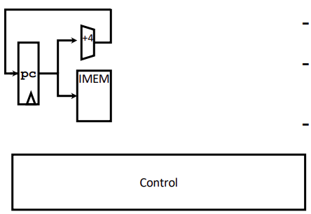
Implementing R-type instructions: Fetch
PC holds the address of our current instruction
What is IMEM?
How does PC change after an R-Type is executed?

Slide 27
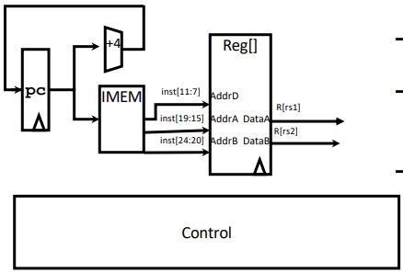
Implementing R-type instructions: Decode
Parse instruction fields (rd, rs1, rs2, operation…) from the instruction
Where do the registers reside?
Register file!
Circuits for reading and writing registers
What are the inputs to the register file?
What are the outputs of the register file?
Notes:
How big is each register address?
How many registers do we have?

Slide 28
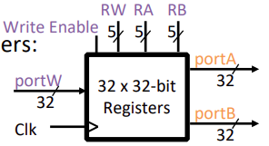
The register file
Register File consists of 32 registers:
Output ports portA and portB
Input port portW
Register selection
Place data of register RA (number) onto portA
Place data of register RB (number) onto portB
Store data on portW into register RW (number) when Write Enable is 1
Clock input (CLK)
CLK is passed to all internal registers so they can be written to if they match RW and Write Enable is 1

Slide 29
Implementing R-type instructions: Decode
Parse instruction fields (rd, rs1, rs2, operation…) from the instruction
Where do the registers reside?
Register file!
Circuits for reading and writing registers
What are the inputs to the register file?
What are the outputs of the register file?
Notes:
How do we select the registers rs1 and rs2?

Slide 30
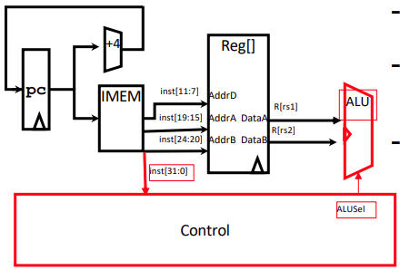
Implementing R-type instructions: Execute
Arithmetic and logical unit
Abstraction for adders, multipliers, dividers, etc.
How do we know what operation to execute?
Our first control bit! ALUSel
Control unit receives instruction also!
ALUSel is a control bit which encodes the operation we should perform on the given operands
The value of ALUSel is a mapping from func3 and func7 values to operations
“if func3 == 000 and func7 == 0000000, perform an add”
Multiple func3, func7 combinations might lead to the same operation! (ie. add and addi)
Notes:
What values can ALUSel take?

Slide 31
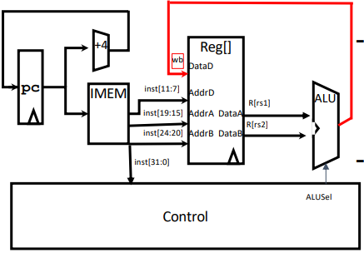
Implementing R-type instructions: Write back

Slide 32
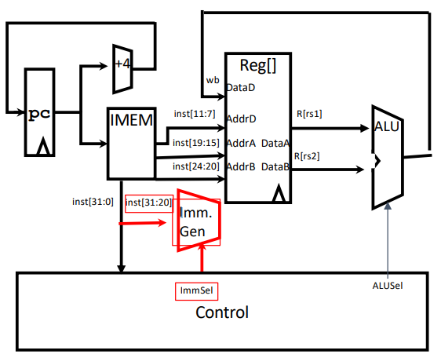
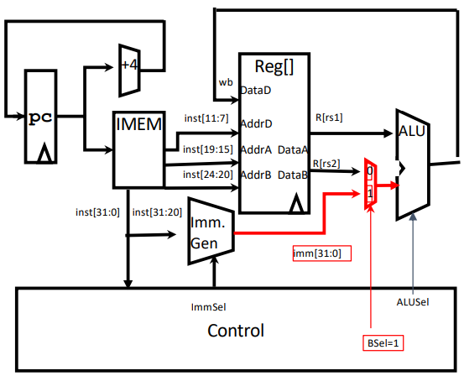
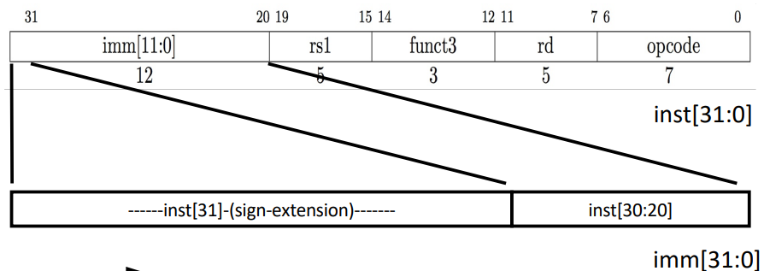
Adding I-type arithmetic instructions to the datapath
A B C D
1. Fetch: addi t0 t2 28
2.1 Decode (parse the instruction and extract different fields): rd = t0; rs1 = t2; rs2 = t3; imm
2.2 Operand fetch (read data): R[t2] R[t3] imm
3. Execute (perform operation): R[t2] + R[t3] + imm
5. Write results back into register: R[t0] = R[t2] + R[t3] + imm
Notes:
What does ImmSel do?
What does BSel do?

Slide 33
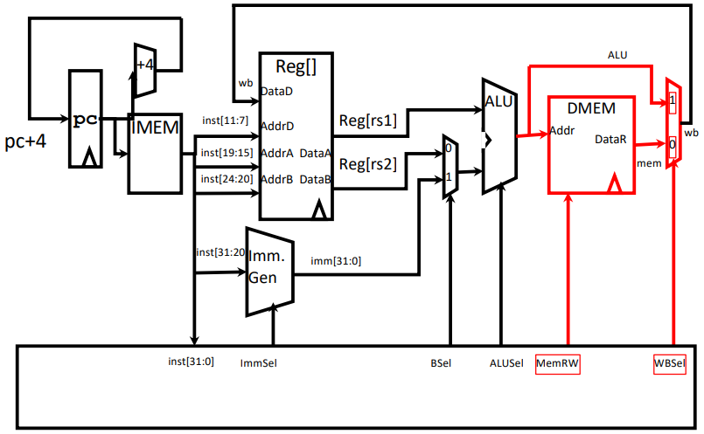
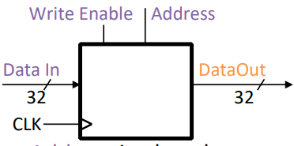
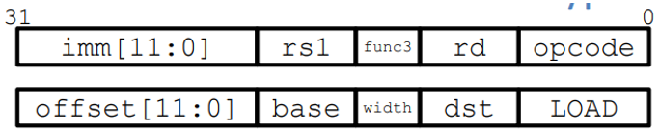
Adding I-type load instructions to the datapath
What do we need for memory access?
A ‘data memory’!
Memory (idealized)
One input port: Data In
One output port: Data Out
Memory access:
Read: Write Enable = 0, data at Address is placed on Data Out
Write: Write Enable = 1, Data In written to Address
Clock input (CLK)
CLK input is a factor ONLY during write operation
During read, behaves as a combinational logic block: Address valid → Data Out valid after “access time”
Notes:
What do we need for memory access? The memory element!
How does the memory work?
Let us look at the new logic again:
When is the ALU path chosen? When is the mem path chosen? (what type of instructions?)
So far, what values can MemRW take?

Slide 34
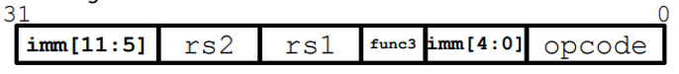
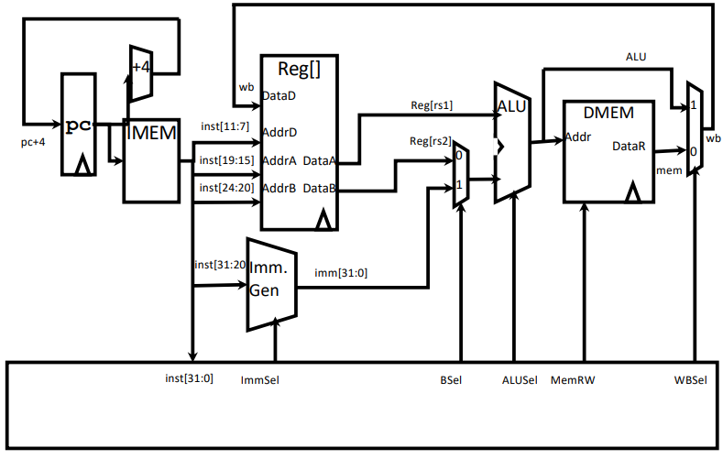
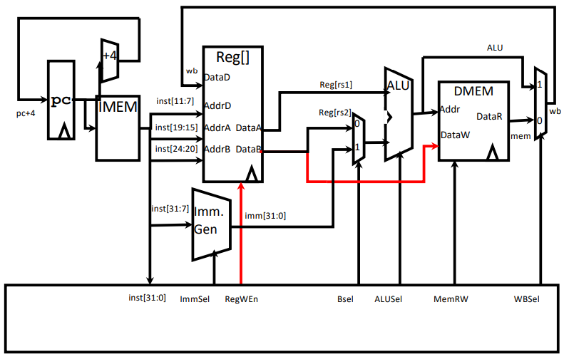
Adding S-type (store) instructions to the datapath
Do we need to change hardware, control, or both?
Can we fetch our instruction?
YES!
Can we decode our instruction?
YES! (Change ImmSel to ‘S-type’)
Can we select the operands we need?
YES! (still R[rs1] and immediate)
Do we have support for the operation we’re performing?
YES! (ALUSel = Add)
Can we access memory correctly?
YES! (MemRW should be 1 for ‘write’)
But… what data are we writing? We need to pass R[rs2] to DMEM
Do we need to update R[rd]?
No! Stores read from R[rs2] but don’t write, so we’ll need a new control bit.
Both hardware and control!

Slide 35
What kinds of instructions are still remaining?
Done: R-type arithmetic, I-type arithmetic, I-type load and I-type store
Modify registers Modify memory
Change program flow: Jumps and branching!
What key features do they require?
Modify the PC

Slide 36
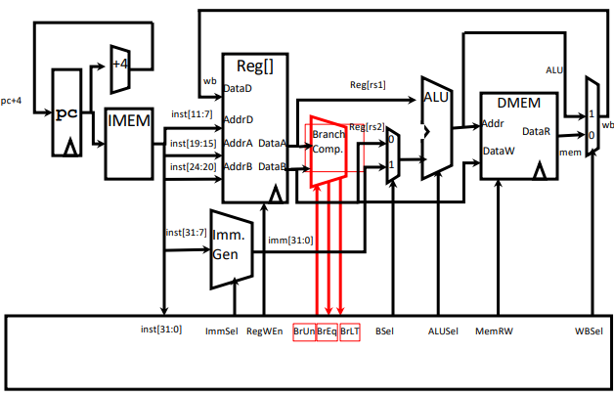
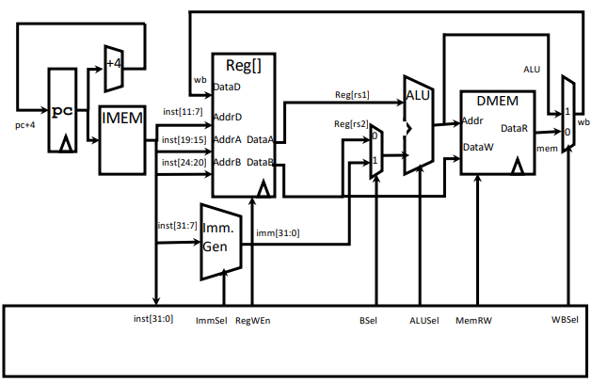
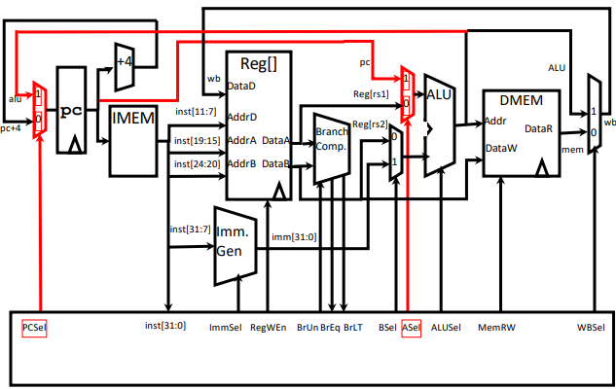
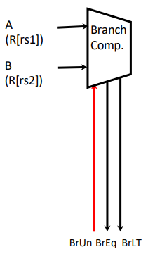
Implementing branches
Branching involves two operations:
Comparison (R[rs1] == R[rs2], possibly , etc.)
Addition (PC = PC + Imm)
Our ALU can do one of these, but not both! We need to add more hardware!
BrEq = 1, if A=B
BrLT = 1, if A < B
BrUn =1 selects unsigned comparison for BrLT, 0=signed
“Output” control signals are used to set other controls!

Slide 37
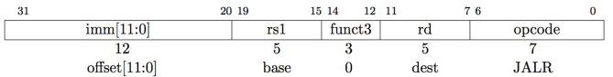
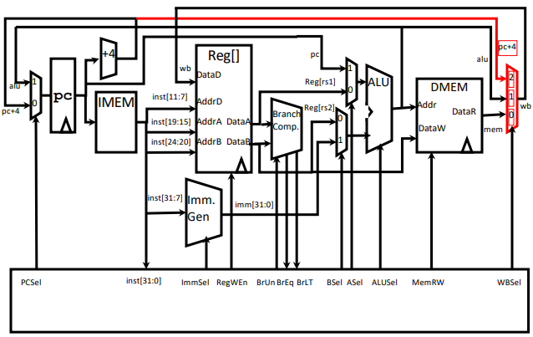
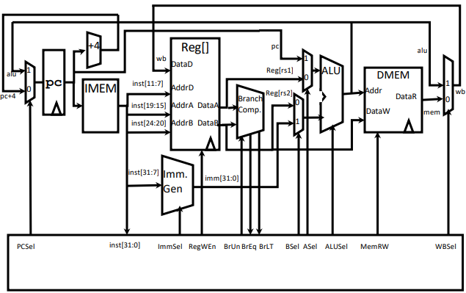
Implementing jumps
JALR rd, rs, immediate
Writes PC+4 to Reg[rd] (return address)
We need to change our MUX to allow this as a write back value!
Sets PC = Reg[rs1] + immediate
We can already feed these arguments into our ALU, so no change here
Uses same immediates as arithmetic and loads
no multiplication by 2 bytes (different from branch!)

Slide 38
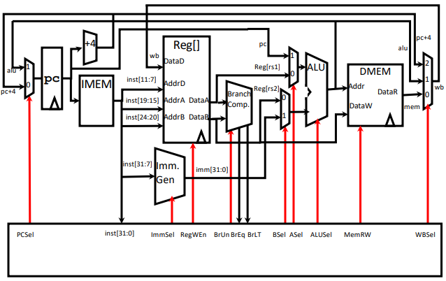
The entire RISC-V RV32l data path

Slide 39
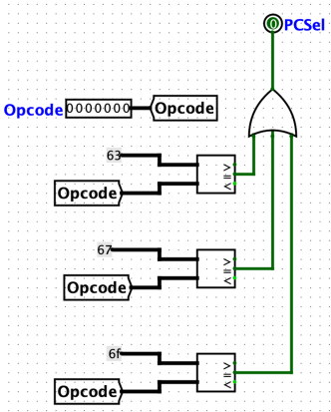
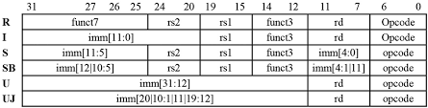
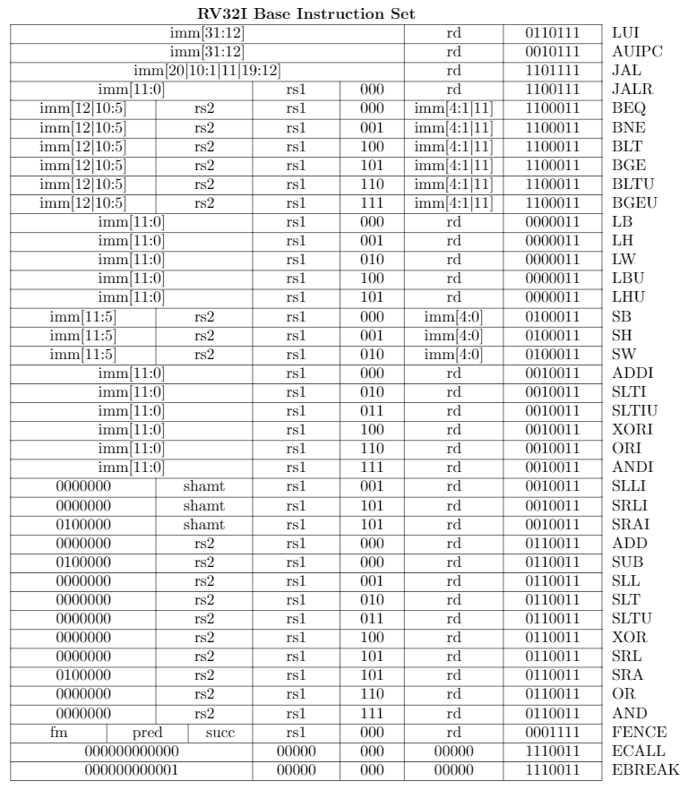
Summary of control signals

Slide 40
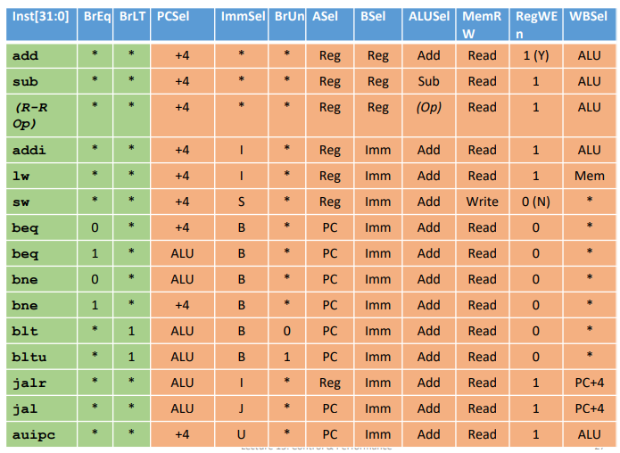
Summary of control signals

Slide 41
Implementing control logic
Combinatorial Logic
Today, chip designers use logic synthesis tools to convert truth tables to networks of gates
Not easily changeable/re-programmable because requires modifying hardware
But! Likely less expensive, more complex
ROM
“Read-Only Memory”
Regular structure (like previous slide’s table)
Can be easily reprogrammed
fix errors
add instructions
Popular when designing control logic manually

Slide 42
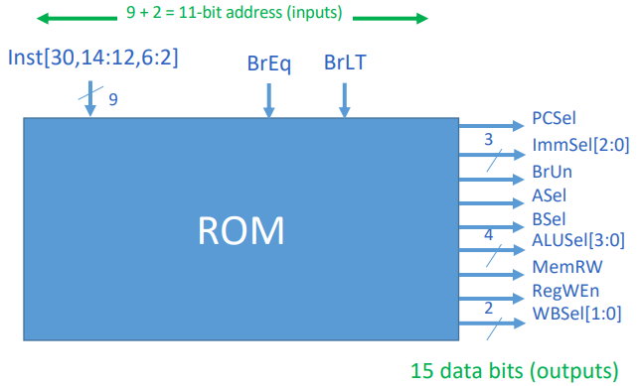
ROM based controller

Slide 43
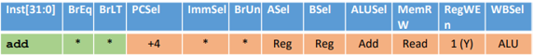

ROM based controller

Slide 44
Administrativia
Minor copies: Next Friday, October 20th
Assignment:
Tutorial tonight at 9 pm!
TA will explain up to part 1 (R-type instructions)
Important instruction
Use the exact commit message that is mentioned in the assignment
Commit and immediately push to Github: otherwise the automatic script will flag your submission!
Extension
Up to Sat. 2 am: no penalty
Up to Sat. 11:59 pm: -1
Up to Sun. 11:59 pm: -2
After that: -3

Slide 45




Combinational and sequential (state) logic

Slide 46

How does information flow through the data path?
When is a new value loaded into the PC?
-> Single cycle processor!
Let us start with the PC, assuming a new value is just loaded into the PC… T = 0
When will the new PC be available at PC input?
T = T_{reg_transfer}
When will the data from current PC appear from IMEM?
T = T_{mem_access}
Assume R-type instruction: when will data from registers appear at the output?
How long does addition / arithmetic take?
T = T_{ALU}
What about other components – AND / OR / NOT gates, (de)multiplexers etc.?

Slide 47
How long does it take to process one full instruction?
memory units (read or write): 200 ps
ALU and adders: 100 ps
register file (read or write): 50 ps
other combinational logic: 0 p

Slide 48


How long does it take to process one full instruction? R-type
memory units (read or write): 200 ps
ALU and adders: 100 ps
register file (read or write): 50 ps
other combinational logic: 0 p
100 ps
0 ps
100 ps
0 ps
50 ps
50 ps
200 ps
Time needed between two rising edges for correct execution: 400 ps

Slide 49


How long does it take to process one full instruction? I-type arithmetic
memory units (read or write): 200 ps
ALU and adders: 100 ps
register file (read or write): 50 ps
other combinational logic: 0 p
100 ps
0 ps
100 ps
0 ps
50 ps
50 ps
200 ps
Time needed between two rising edges for correct execution: 400 ps
0 ps

Slide 50


How long does it take to process one full instruction? I-type load
memory units (read or write): 200 ps
ALU and adders: 100 ps
register file (read or write): 50 ps
other combinational logic: 0 p
100 ps
0 ps
100 ps
0 ps
50 ps
200 ps
50 ps
200 ps
Time needed between two rising edges for correct execution: 600 ps
0 ps

Slide 51



How long does it take to process one full instruction? Store
memory units (read or write): 200 ps
ALU and adders: 100 ps
register file (read or write): 50 ps
other combinational logic: 0 p
100 ps
0 ps
100 ps
0 ps
50 ps
200 ps
50 ps
200 ps
Time needed between two rising edges for correct execution: 550 ps
0 ps

Slide 52



How long does it take to process one full instruction? Branch
memory units (read or write): 200 ps
ALU and adders: 100 ps
register file (read or write): 50 ps
other combinational logic: 0 p
100 ps
0 ps
100 ps
0 ps
50 ps
200 ps
50 ps
200 ps
Time needed between two rising edges for correct execution: 300 ps
0 ps

Slide 53

Single-cycle processor – performance metrics
How long does the clock cycle have to last?
Clock cycle time of the microarchitecture is determined by how long it takes to complete the slowest instruction
Critical path of the design is determined by the processing time of the slowest instruction
What is the fastest processor speed possible for a single cycle RISC-V CPU?
1/(600 ps) == 1.33 GHz
Execution time
Energy consumption

Slide 54



CPU performance metrics – execution time

Slide 55


CPU performance metrics – energy consumption
Why can we not make V (supply voltage) → 0?
What about C?
Cost-effective air-cooled chip limit around ~150W

Slide 56
Taking stock
All combinational circuit elements are active simultaneously
Energy consumption?
Design complexity?
RISC vs CISC microarchitecture
Size of instructions
Memory footprint
Complexity of microarchitecture design
Space footprint
Power considerations
Speed considerations
What architecture does your i3/i5/i7 chip use?

Slide 57

What if we want to add a new instruction? Microprogramming: A more flexible CPU design
Advantages:
Add new instructions
Fix bugs after production
Disadvantages:
Cost
Efficiency
Space
# transistors
RISC-V microcode.pdf

Slide 58
Microprogramming example
Controller is a state machine (FSM), with transitions defined as:
N: go to next state
S: do nothing (if ‘busy?’ is asserted) else next state
D: check opcode and func and go to correct state
J: Jump to a particular state
EZ, NZ: Jump if condition true else next state
add t0 t1 t2
State | Pseudocode | IRLd | RegSel | RegWr | RegEn | ALd | BLd | ALUop | ALUen | MALd | MemWr | MemEn | ImmSel | ImmEn | mBr | Next
FETCH0 | PC->MA, A | * | PC | 0 | 1 | 1 | * | * | 0 | 1 | 0 | 0 | * | 0 | N
FETCH1 | Mem->IR | 1 | * | 0 | 0 | 0 | * | * | 0 | 0 | 0 | 1 | * | 0 | S
FETCH2 | ALU->PC | 0 | PC | 1 | 0 | 0 | * | INC_A_4 | 1 | * | 0 | 0 | * | 0 | D
ADD0 | R[t1]->A
ADD1 | R[t2]->B
ADD2 | ALU->R[t0]
ADD3 | GOTO FETCH0

Slide 59
How can we increase the speed of our processor?
Faster clock
What are the limitations?
Faster devices
What are the limitations?
Will talk about this in the next topic – memory management!
Parallelize instruction processing

Slide 60


Pipelined multi-cycle processors
Does not decrease the latency of individual instructions
Increases the throughput of instructions
Speedup α #stages
Rate limited by slowest stage

Slide 61

Pipelined RISC-V processor

Slide 62

Pipelined RISC-V processor
What problems do you see here?

Slide 63
Pipelining hazards
A hazard is a situation that prevents starting the next instruction in the next clock cycle
Structural hazard
A required resource is busy
(e.g. needed in multiple stages)
Data hazard
Data dependency between instructions
Need to wait for previous instruction to complete its data write
Control hazard
Flow of execution depends on previous instruction

Slide 64


Structural hazard
Problem: Two or more instructions in the pipeline compete for access to a single physical resource
Solution 1: Instructions take turns using resource, some instructions have to stall (wait)
Solution 2: Add more hardware to machine
Can always solve a structural hazard by adding more hardware
Multiple ports to the regfile solves the access problem
Is this a problem for Harvard or von Neuman architecture (or both)?
Soln: Separate data and instruction caches
ISA designed to avoid multiple accesses

Slide 65


Data hazards
RAW, WOW and WAR type hazards
In-order pipelines
Out-of-order pipelines

Slide 66

Data hazard solution – bubbles (stalling)
Bubbles: affected pipeline stages do “nothing”
Stalls reduce performance
Compilers can arrange the instructions such that these conditions are avoided
Compilers have to know how the pipeline is implemented and how instructions interact

Slide 67

Data hazard solution – forwarding
Forwarding: grab operand from pipeline stage, rather than register file
Needs changes in datapath hardware as well as extra control signals!

Slide 68

Data hazard solution – forwarding

Slide 69


Data hazards – forwarding does not always work!
Hardware can stall the pipeline – hardware interlocks
Slot after ‘load’ is called a ‘load delay slot’
Re-ordering code, if possible, is always a good solution!

Slide 70
Control hazards – branch stalls
Fetching next instruction depends on branch outcome
Pipeline can’t always fetch correct instruction
Result isn’t known until end of execute

Slide 71

Control hazards – branch stalls
If branch not taken, then instructions fetched sequentially after branch are correct
If branch or jump taken, then need to flush incorrect instructions from pipeline by converting to NOPs
Branch prediction
Branch history tables
Many more innovations…
Notes:
Backward branches are usually taken (loops)

Slide 72


